Slide 1
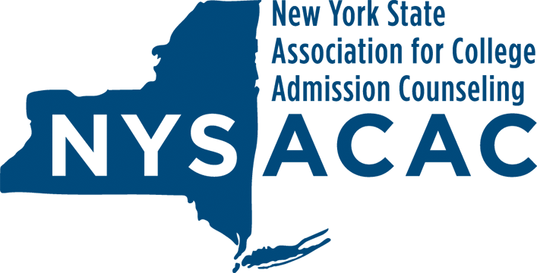
Transfer: An Integral Part of College Attainment and Student Success
An Open Discussion
NYSTAA Summer Workshop Series
May 28, 2020

Slide 2
NYSACAC Representatives:
- Stephanie Espina, Director of Undergraduate Admission at Adelphi University and President of NYSACAC
- Kurt Thiede, Higher Ed Consultant and Project Manager of NYSACAC Gates Project

Slide 3
Why We are Here:
- NYSACAC received a grant from Gates Foundation
- NYSACAC will join other NY State organizations to:
                + identify ways to increase student access to postsecondary education and, ultimately, succeed
                +in particular, focus on issues relating to transfer students
                - NYSTAA is an important resource and partner in this effort

Slide 4
What We’d Like to Accomplish
                After providing you with a brief description of the work we are doing, we would like to solicit your input on:
                - transfer practices that support student success
                +ways we can elevate and share these practices
                - transfer practices that inhibit student success
                +ways we can address and modify these to support student success

Slide 5
Briefly
                The project’s deliverables:
                1. Statewide Convenings of stakeholder groups with the goal of contributing to a statewide advocacy strategy for a postsecondary attainment goal. (Now being accomplished via weekly Virtual Conversations on various transfer-related topics.)
                2. Case Studies about community college to four-year college transfer practices that inhibit student success.
                3. A document of Best (and Transferable) Practices that support transfer student success.

Slide 6
So, Let’s Get Started:
                Transfer Information to Frame Our Conversation (1 of 2)
                + While steadily declining from its post-Great Recession high mark of 8.2 M (2010), community college enrollments continue to represent a significant pool of potential students for four-year institutions.
                -FA2018 – 2.4 M full-time & 4.4 M part-time (AACC)
                +In 2017, 23% of the 2.9 M high school graduates enrolled at two-year colleges (44% in four-year colleges). (NCES)
                +In 2018, 35% of college students transferred – 56% of these from community colleges. (NCES)

Slide 7
So, Let’s Get Started:
                Transfer Information to Frame Our Conversation (2 of 2)
                +In a 2014 NCES report on credit transferability the following observations were made:
                - the transfer of credits for students moving from 2-yr -> 4-yr colleges (vertical transfer) was more favorable when compared to:
                - transfer from 2-yr -> 2-yr colleges, 4-yr -> 2-yr colleges, or 4-yr- 4-yr colleges. (NCES)
                +In a 2019 report on college student persistence, the Jack Kent Cooke Foundation showed that community college students transferring into selective colleges graduated at a higher rate (75%) than native students (73%) and 4-year college transfers (61%). In this same report, the Foundation estimated that annually more than 50,000 high-achieving community college students from low-SES backgrounds do not transfer to complete a baccalaureate degree. (JCKF)

Slide 8
So, Let’s Get Started:
                Your Thoughts:
                1. Statewide Convenings – albeit in a virtual format - of stakeholder groups with the goal of establishing a statewide advocacy strategy for a postsecondary attainment goal.
                What stakeholder groups might be added to the mix?
                2. Case Studies about community college to four-year college transfer practices that inhibit student success.
                Where have your students experienced “leaks” in the student transfer “pipeline?”
                3. A document of Best (and Transferable) Practices that support transfer student success.
                What should we be celebrating and sharing?

Slide 9
Many Thanks!

